Slide 1

Dear Servas Japan!

Slide 2
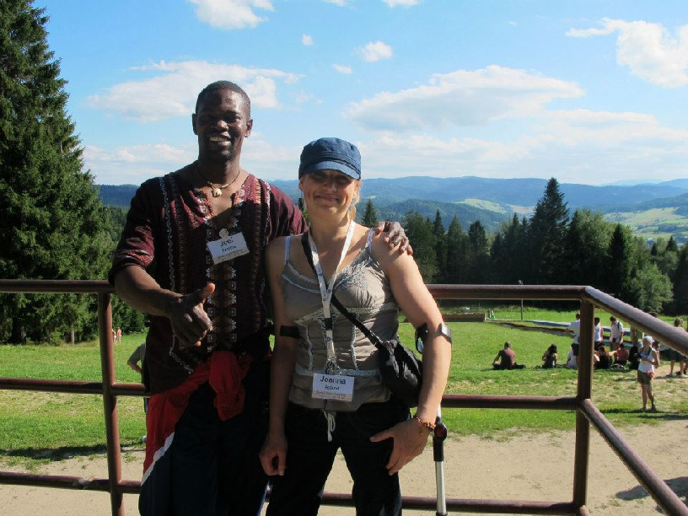
We’d like to tell you about Servas Youth

Slide 3
Servas Youth Structure
Youth Outreach
Servas Youth Language Experience (SYLE)
Program development
Youth Events
Technology

Slide 4
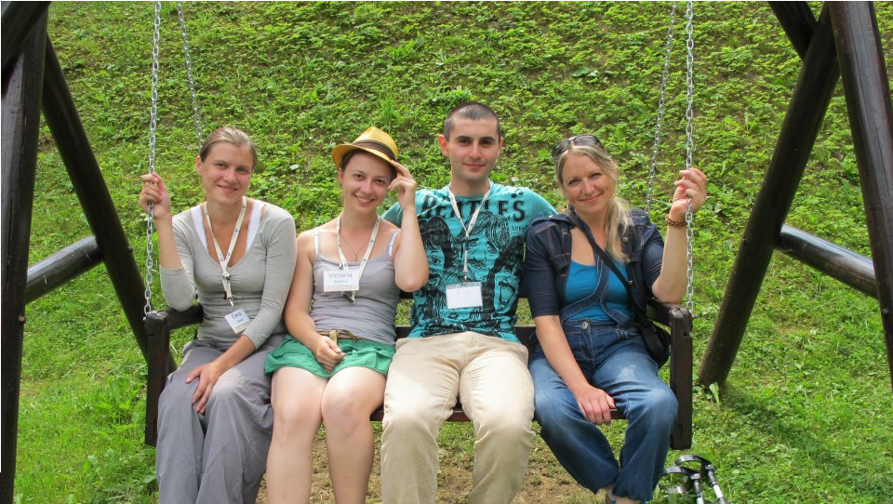
Have you ever wanted to spend a week with young people from all over the World?
Make new friends (not only on Facebook;)) ?
Have fun on an international scale?
Share cultures and experiences?

Slide 5
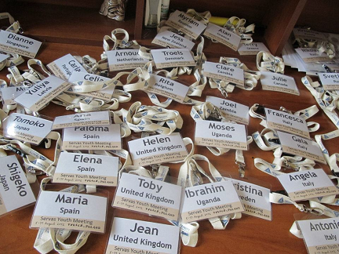
Take part in a Servas Youth event!
7 International events so far
1000 participants
Millions of laughs shared!
And there is more to come!

Slide 6
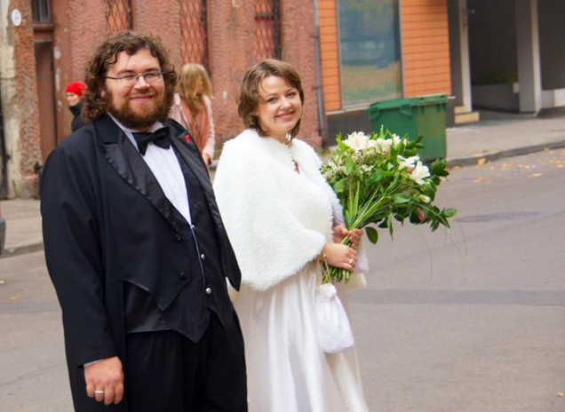
One marriage arranged!

Slide 7
Do you know where we’ve been already?
Denmark 2011
UK 2007
Turkey 2008
Poland 2012
Mexico 2010
Uganda 2011
Argentina 2006

Slide 8
Have you heard about SYLE?
(Servas Youth Language Experience)
Have you ever wanted to learn a foreign language in a foreign country?
From local people?
Learn about their culture?
Teach foreigners your native language and culture?

Slide 9
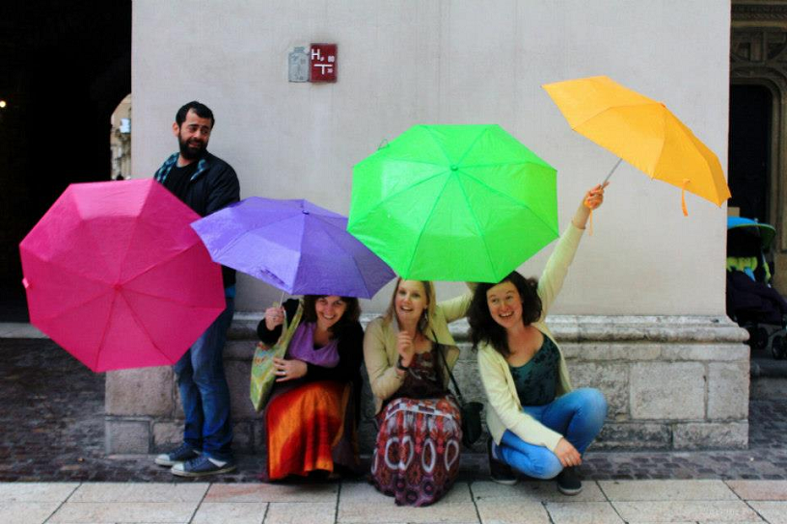
We all know that Servas is a peace organization, but did you know that Servas Youth is the funniest way to spread peace?

Slide 10
SOME OF ACTIVITIES THAT YOU CAN DO AS SERVAS YOUTH INCLUDES………

Slide 11
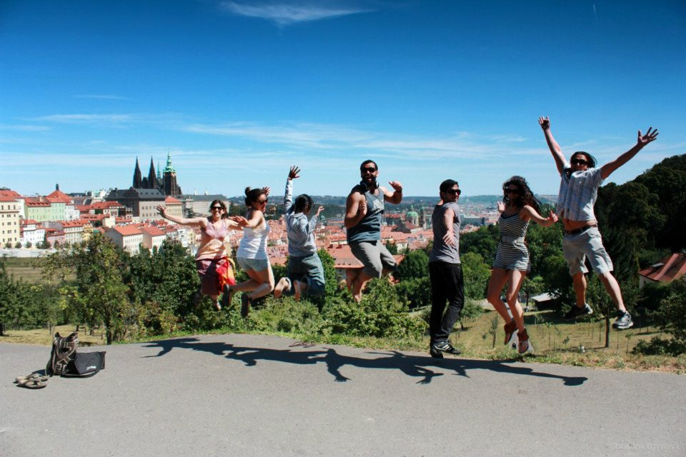
………….JUMPING PHOTOS

Slide 12
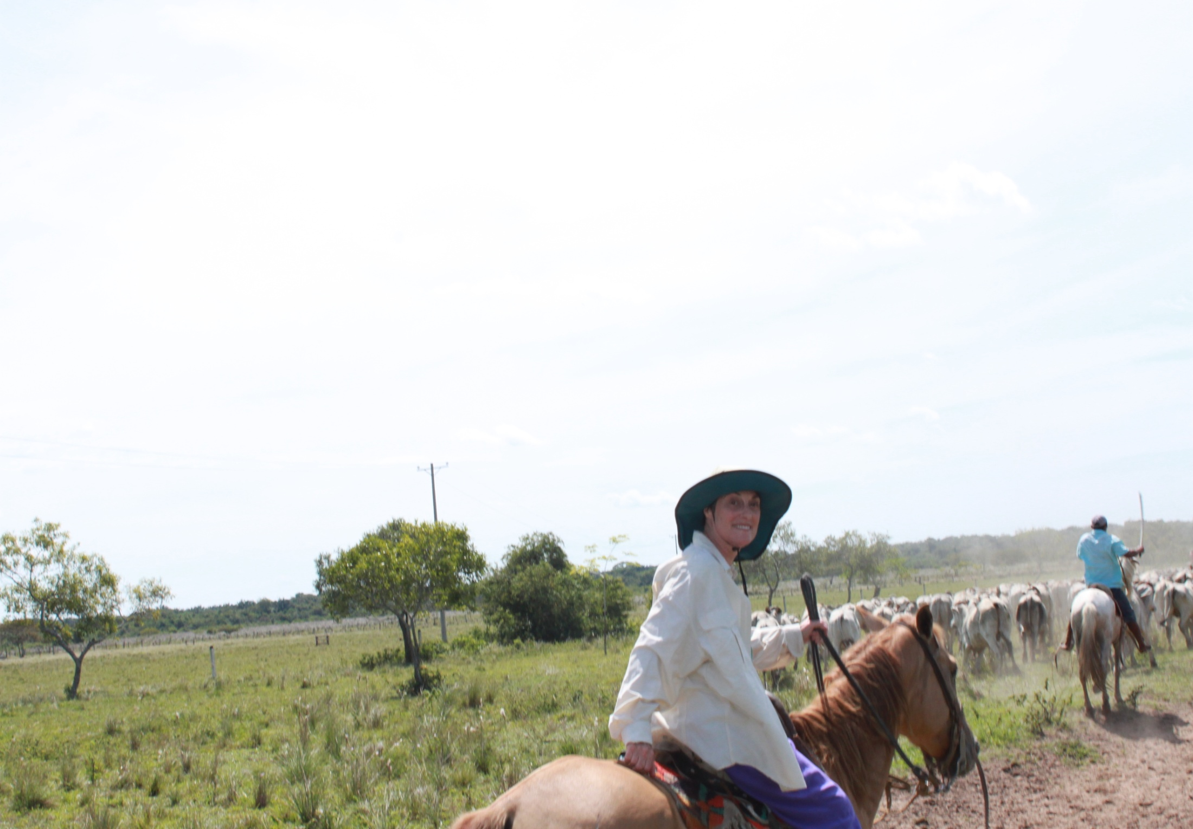
……BE A COWBOY IN COLOMBIA

Slide 13
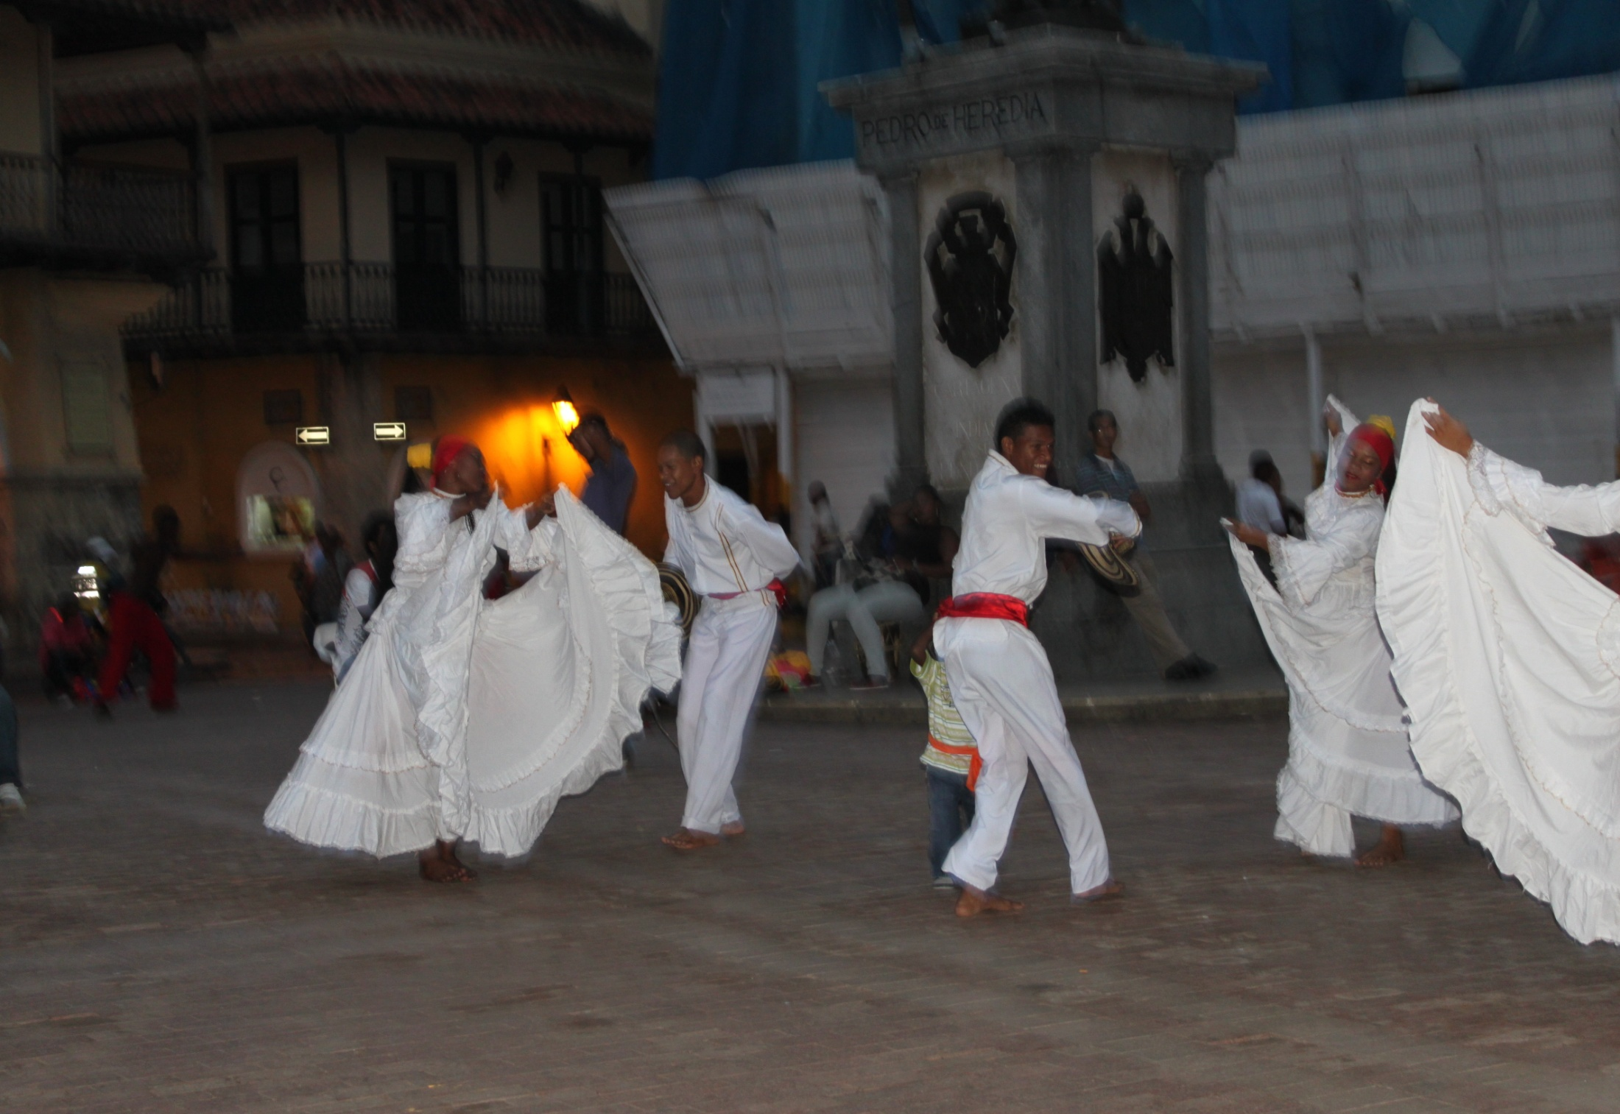
…....DANCE SOME CUMBIA

Slide 14
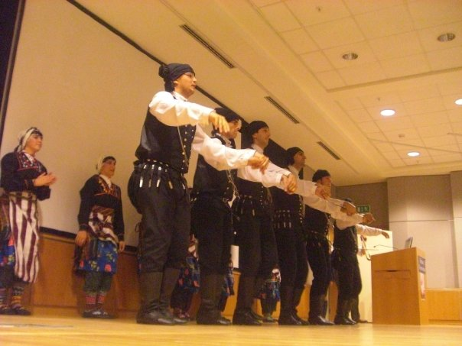
…DANCING TRADITIONAL DANCES IN ISTANBUL

Slide 15
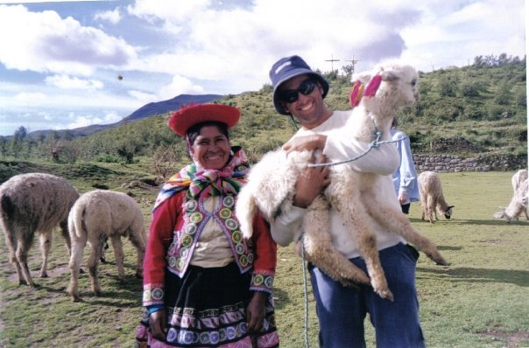
…ALPACA EXPERIENCES IN PERU

Slide 16
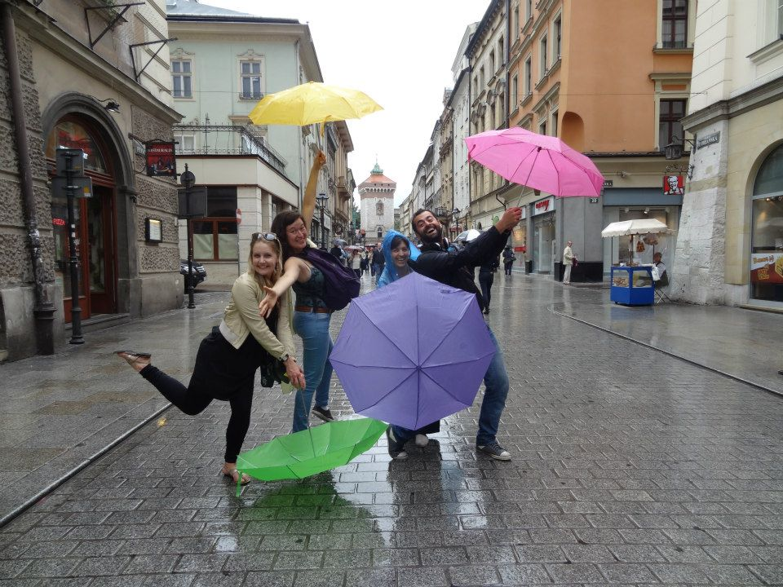
..UMBRELLA EXPERIENCE IN POLAND

Slide 17
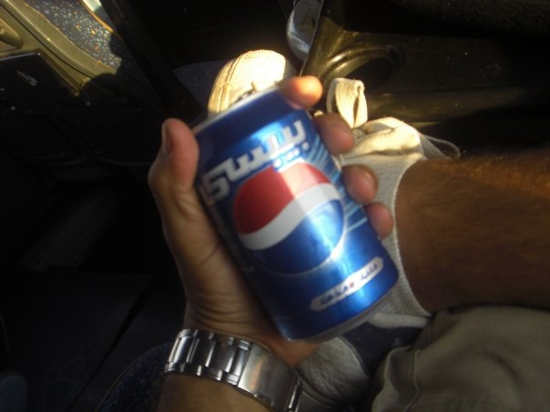
....LANGUAGE EXPERIENCES in 153 COUNTRIES

Slide 18
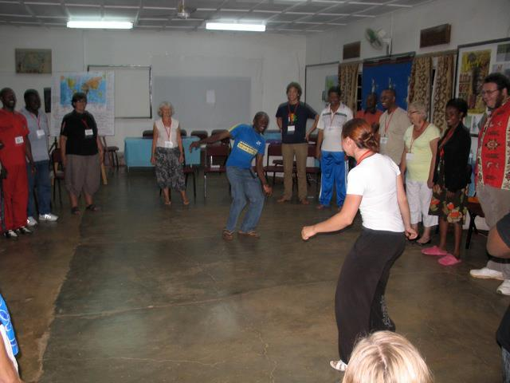
…..AFRICAN DANCE IN UGANDA

Slide 19
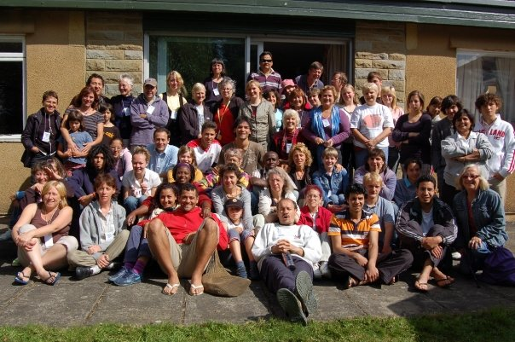
……RELAX IN THE UNITED KINGDOM

Slide 20
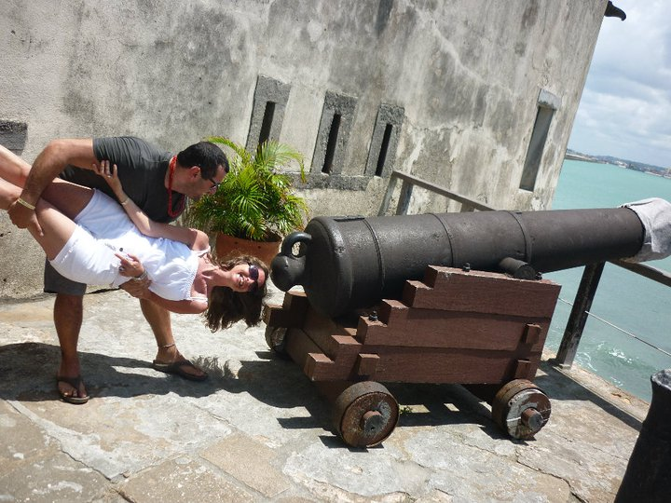
……..ENJOY BRASIL

Slide 21
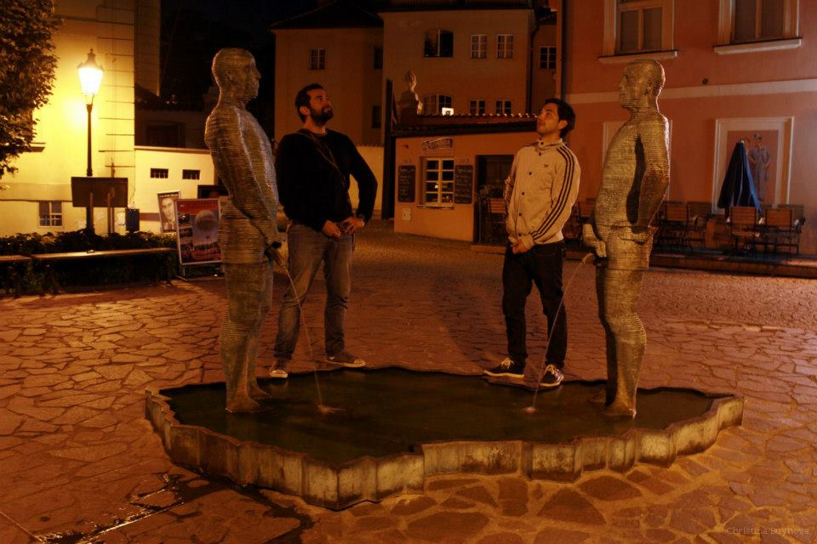
…..BE LIKE A STATUE IN PRAGUE

Slide 22
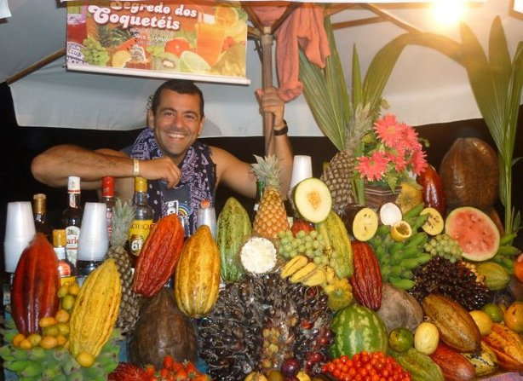
…..TASTE SOME TROPICAL FRUITS

Slide 23
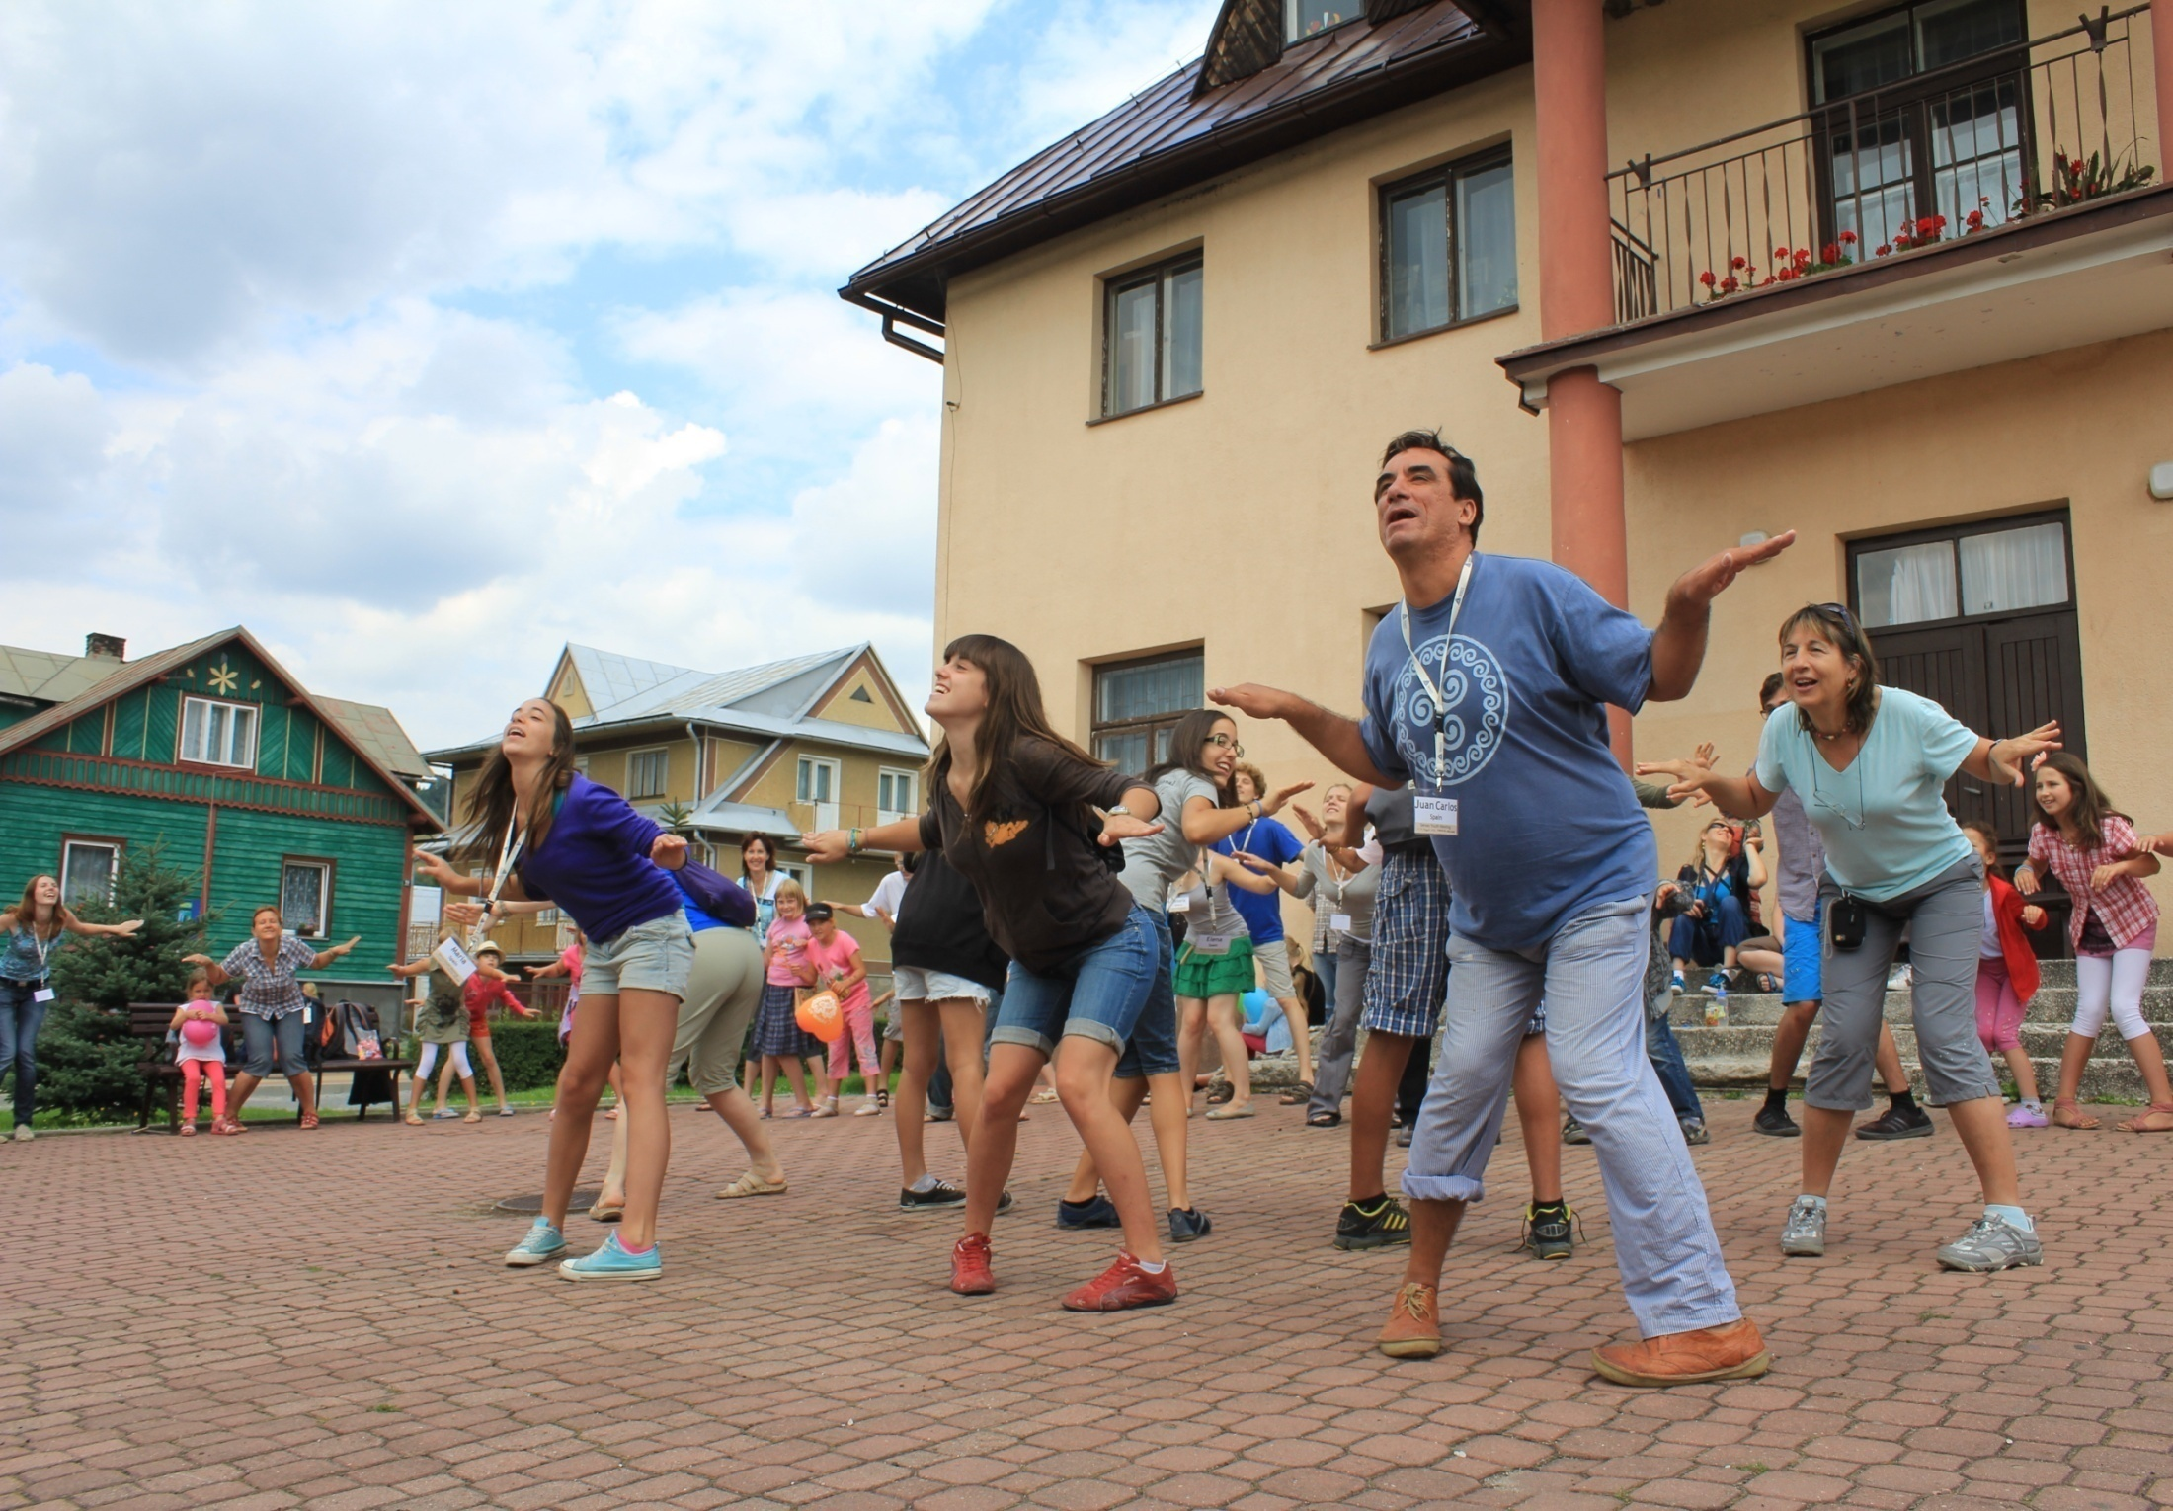
…..CREATE NEW MOVEMENTS

Slide 24
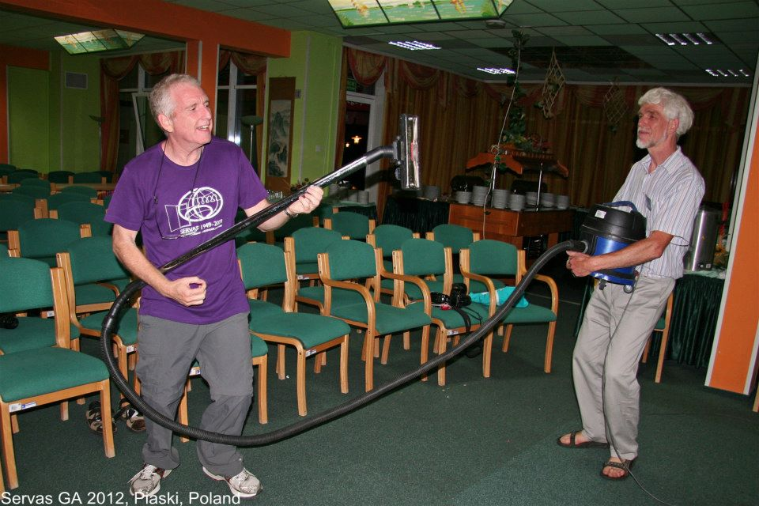
…….PLAY NEW INSTRUMENTS

Slide 25
THE WORLD WITHOUT LIMITS
ENJOY YOUR LIFE
JOIN SERVAS!!!

Slide 26
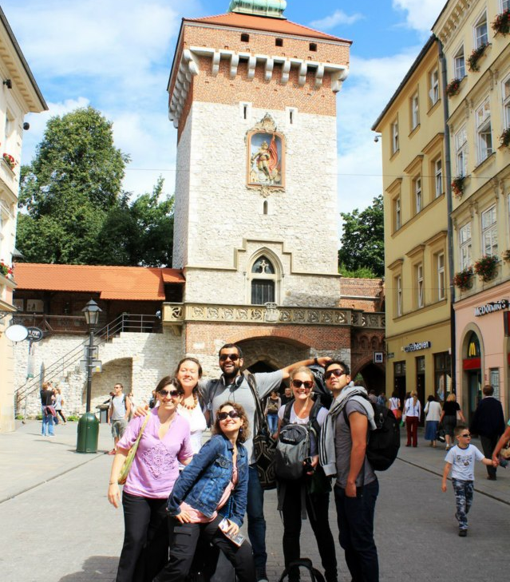
Want to know more about Servas Youth?
Contact us: youth@servas.org
Website: www.servasyouth.org
Facebook: www.Facebook.com/servasyouth

Slide 27
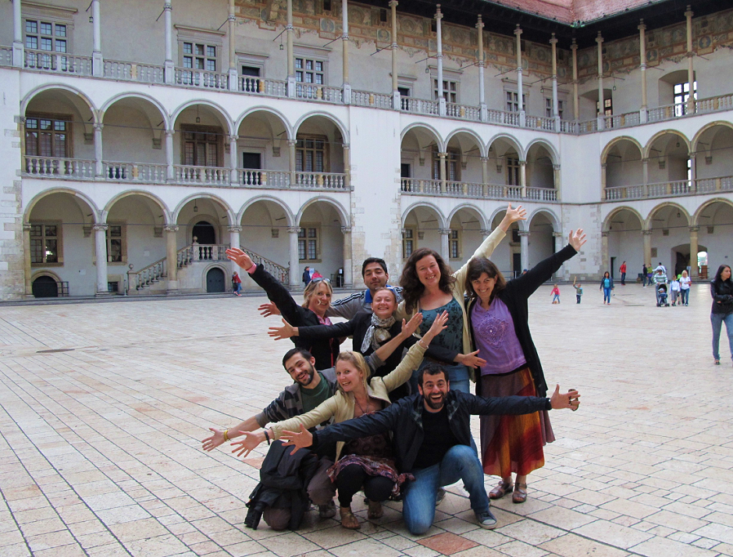
We are waiting for you!

